Slide 1
Practicing Select and Creating view

Slide 2
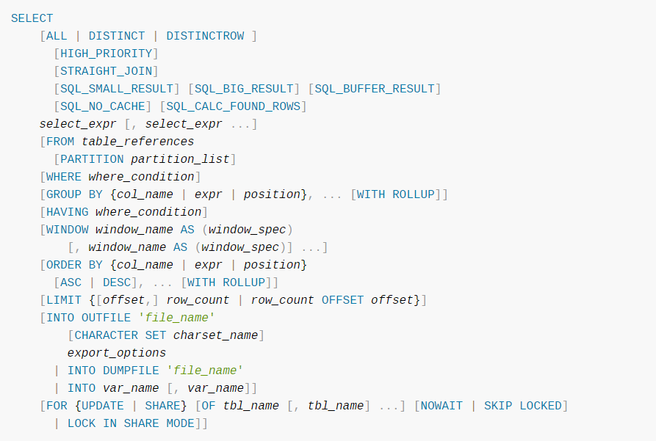

Slide 3
mysql> SELECT 1 + 1;
-> 2
A select list consisting only of a single unqualified * can be used as shorthand to select all columns from all tables:
SELECT *
FROM t1 INNER JOIN t2
tbl_name.* can be used as a qualified shorthand to select all columns from the named table:
SELECT t1.*, t2.*
FROM t1 INNER JOIN t2

Slide 4
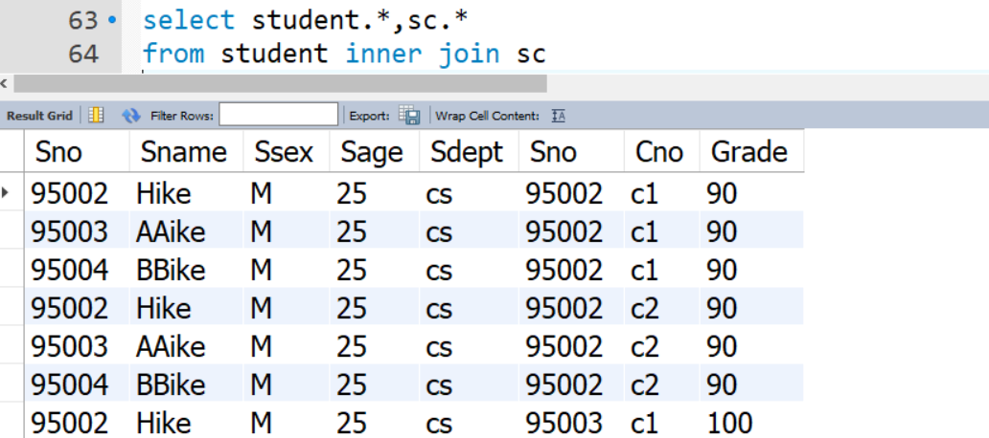
在不使用on语法时，join、inner join、逗号、cross join结果相同，都是取2个表的笛卡尔积。

Slide 5
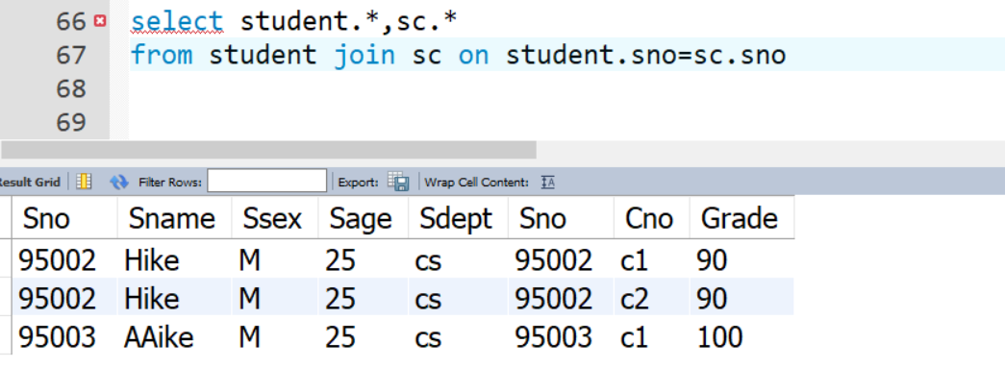
用on自然连接

Slide 6
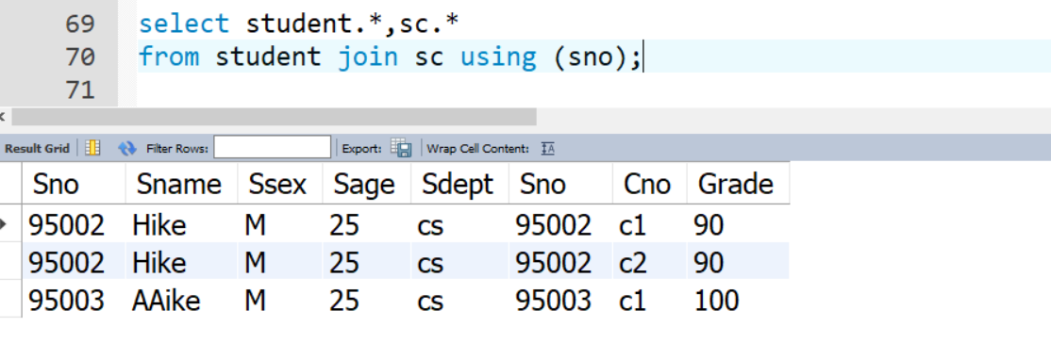
用using连接

Slide 7
on语法：筛选连接后的结果，两表的对应列值相同才在结果集中，可以通过and连接多个列值的匹配要求，列名可以不同
select *
from tb_test1 inner join tb_student on tb_test1.id=tb_student.id;
using语法：筛选连接后的结果，两表的对应列值相同才在结果集中，括号内用多个列名要求用逗号连接，列名必须相同
select *
from tb_test1 cross join tb_student using(id);

Slide 8
INNER JOIN（内连接,或等值连接）：获取两个表中字段匹配关系的记录。
LEFT JOIN（左连接）：获取左表所有记录，即使右表没有对应匹配的记录。
RIGHT JOIN（右连接）： 与 LEFT JOIN 相反，用于获取右表所有记录，即使左表没有对应匹配的记录。
mysql没有全外连接，用union将左右外连接合并。

Slide 9
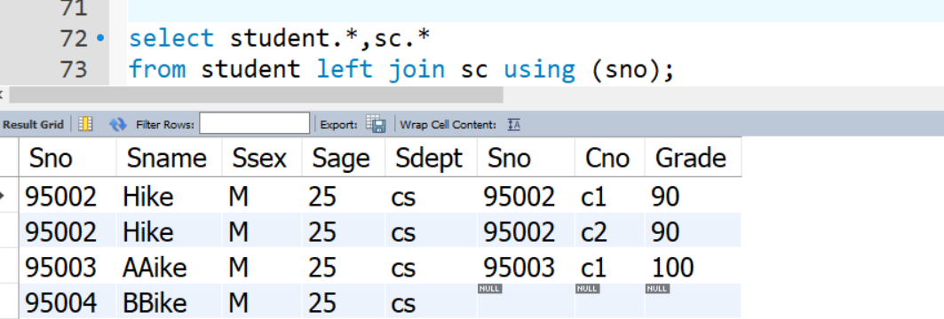

Slide 10
SELECT AVG(score), t1.*
FROM t1
SELECT CONCAT(last_name,', ',first_name) AS full_name
FROM mytable
ORDER BY full_name;

Slide 11
GROUP BY子句
GROUP BY子句分组：
细化聚集函数的作用对象
未对查询结果分组，聚集函数将作用于整个查询结果
对查询结果分组后，聚集函数将分别作用于每个组
作用对象是查询的中间结果表
按指定的一列或多列值分组，值相等的为一组

Slide 12
GROUP BY子句（续）
[例31] 求各个课程号及相应的选课人数。
SELECT Cno，COUNT(Sno)
FROM SC
GROUP BY Cno；
查询结果：
Cno COUNT(Sno)
1 22
2 34
3 44
4 33
5 48

Slide 13
GROUP BY子句（续）
[例32] 查询选修了3门以上课程的学生学号。
SELECT Sno
FROM SC
GROUP BY Sno
HAVING COUNT(*) >3；

Slide 14
GROUP BY子句（续）
HAVING短语与WHERE子句的区别：
作用对象不同
WHERE子句作用于基表或视图，从中选择满足条件的元组
HAVING短语作用于组，从中选择满足条件的组。

Slide 15
SELECT a, COUNT(b)
FROM test_table
GROUP BY a
ORDER BY NULL;

Slide 16
The HAVING clause can refer to aggregate functions, which the WHERE clause cannot:
SELECT user, MAX(salary)
FROM users
GROUP BY user
HAVING MAX(salary) > 10;

Slide 17
动态sql语句
For prepared statements, you can use placeholders. The following statements will return one row from the tbl table:
SET @a=1;
PREPARE STMT
FROM 'SELECT * FROM student LIMIT ?';
EXECUTE STMT USING @a;
The following statements will return the second to sixth row from the tbl table:
SET @skip=1;
SET @numrows=5;
PREPARE STMT
FROM 'SELECT * FROM tbl LIMIT ?, ?';
EXECUTE STMT
USING @skip, @numrows;

Slide 18
视图（View）是一种虚拟存在的表。其内容与真实的表相似，包含一系列带有名称的列和行数据。但是视图并不在数据库中以存储的数据的形式存在。
行和列的数据来自定义视图时查询所引用的基本表，并且在具体引用视图时动态生成。
视图的特点如下：
<1> 视图的列可以来自不同的表，是表的抽象和在逻辑意义上建立的新关系；
<2> 视图是由基本表（实表）产生的表（虚表）；
<3> 视图的建立和删除不影响基本表；
<4> 对视图内容的更新（增删改）直接影响基本表；
<5> 当视图来自多个基本表时，不允许添加和删除数据。

Slide 19
CREATE
[OR REPLACE]
[ALGORITHM = {UNDEFINED | MERGE | TEMPTABLE}]
[DEFINER = { user | CURRENT_USER }]
[SQL SECURITY { DEFINER | INVOKER }]
VIEW view_name [(column_list)]
AS select_statement
[WITH [CASCADED | LOCAL] CHECK OPTION]

Slide 20
The CREATE VIEW statement creates a new view, or replaces an existing view if the OR REPLACE clause is given. If the view does not exist, CREATE OR REPLACE VIEW is the same as CREATE VIEW. If the view does exist, CREATE OR REPLACE VIEW replaces it.
The WITH CHECK OPTION clause can be given to constrain inserts or updates to rows in tables referenced by the view.

Slide 21
The following example defines a view that selects two columns from another table as well as an expression calculated from those columns:
mysql> CREATE TABLE t (qty INT, price INT);
mysql> INSERT INTO t VALUES(3, 50);
mysql> CREATE VIEW v
AS
SELECT qty, price, qty*price AS value
FROM t;
mysql> SELECT * FROM v;
+------+-------+-------+
| qty | price | value |
+------+-------+-------+
| 3 | 50 | 150 |
+------+-------+-------+

Slide 22
A view definition is subject to the following restrictions:
The SELECT statement cannot contain a subquery in the FROM clause.
The SELECT statement cannot refer to system variables or user-defined variables.
Within a stored program, the SELECT statement cannot refer to program parameters or local variables.
The SELECT statement cannot refer to prepared statement parameters.
Any table or view referred to in the definition must exist. If, after the view has been created, a table or view that the definition refers to is dropped, use of the view results in an error. To check a view definition for problems of this kind, use the CHECK TABLE statement.
The definition cannot refer to a TEMPORARY table, and you cannot create a TEMPORARY view.
You cannot associate a trigger with a view.
Aliases for column names in the SELECT statement are checked against the maximum column length of 64 characters (not the maximum alias length of 256 characters).

Slide 23
实践
用SQL语句完成图书管理系统book 数据库相关数据录入，同时使用相关语句进行：
新表中插入数据（使用into子句）
从某表中查询结果，分组，排序（使用select from，where，group by，having，order by子句）
对数据库进行联合查询（使用Union子句）
进行多表查询（等值、不等值，自然，外连接，自连接等）
进行子查询（in，exists，having中使用）
创建视图
针对movies数据库，做lab1.pdf，lab2.pdf上面的练习。
要求：
实验报告中除文字描述外，必须提供每一操作对应的SQL语句word文档，并附上执行结果截图。

Slide 24
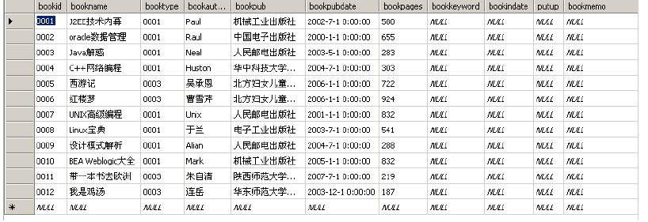
book 表数据

Slide 25
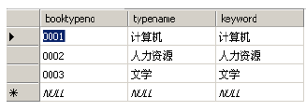
booktype 表数据

Slide 26
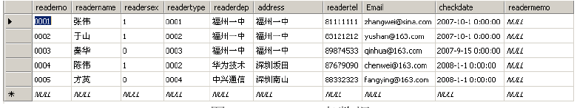
readers 表数据

Slide 27
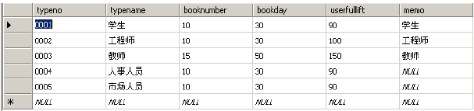
readertype 表数据

Slide 28
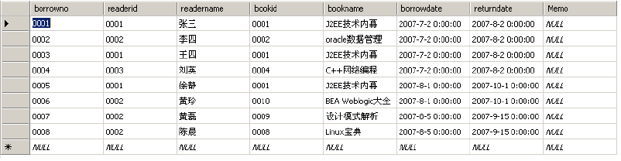
borrowinfo 表数据

